Slide 1

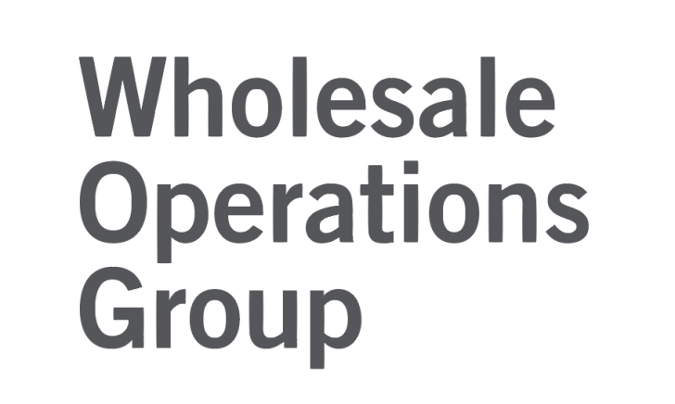


PRESENTATION TO ONTARIO BEER MANUFACTURERS
Information session on the process for registering Ontario beer products for sale in the grocery channel.
October 8 &14, 2015

Slide 2
Today’s Agenda
PRESENTATION: 30 MINUTES
1 - New rules & regulations
Summary of the policy change and new program
2- How it will work: roles and responsibilities
LCBO (wholesaler)
Suppliers (beer manufacturers)
grocers (grocers)
3- Getting products listed
Steps to follow
Timeframes
Requirements
Q&A DISCUSSION: 30 MINUTES

Slide 3
After today’s session:
Detailed process steps to further help guide you.
IT systems and Financial transaction guidelines to follow.
Wholesale Operations Group full contact list.
Follow-up sessions get early feedback and answer questions.

Slide 4


1 - New rules and regulations take effect
Policy change

Slide 5
April
Premier’s Advisory Council on Government Assets (“PAC”)
Striking the Right Balance: Modernizing Beer Retailing/Distribution in Ontario
150 grocer licences before May 2017 to sell beer to the public.
Maximum of 450 total.
June
Ontario Budget
Building Ontario Up
Province announced it would proceed with this recommendation.
September
LCBO RFB
RFB 2015-010 Wholesale supply agreements for beer
Deadline for submissions is November 6, 2015.
Up to 60 grocery stores before e/o/2015.

Slide 6
The LCBO’s increased mandate
An operational enterprise of the Province.
Importer of record for all beverage alcohol products in Ontario.
Wholesaler of record for all beer sold by grocers.

Slide 7
Beer eligibility requirements
Some key AGCO regulations:
750 millilitres or less.
Total alcohol content cannot exceed 7.1 % ABV.
Only packages with 6 containers or less.
No malt-based coolers.

Slide 8
Beer eligibility requirements cont’d.
20% of beer on display to consumers must be produced by small brewers (<400,000 hectolitres/yr).
  Brewers offering products for grocer sale will need to inform the LCBO of their annual global volume.

Slide 9
Beer eligibility requirements cont’d.
Also to note:
Grocers cannot have financial interest in a brand or trademark of beer offered.
All products must be made available to all grocers; no exclusive products nor private label brands.
No retail-level discounts or rebates for multiple package buying.
NOTE: Complete list of requirements found in the ONTARIO REGULATION 290/15 - GOVERNMENT STORES regulation, available online https://www.ontario.ca/laws/regulation/150290

Slide 10
Shelf price = Uniform price
The retail price for beer sold to the public will be as determined by brewers (and communicated to grocers by the LCBO).
It will be the same through all retail channels.

Slide 11


2 - How it will work
Roles & responsibilities

Slide 12
Enabling you to pursue sales opportunities
CONDUIT TO OPPORTUNITY
The LCBO Wholesale Operations Group is here to serve as a conduit for you to grow your businesses by selling through the new grocery channel.
YOUR CHOICE TO PROCEED OR NOT
It is your decision to determine whether you wish to sell through this channel, and up to what degree if you choose to do so.

Slide 13
We are your partner in selling through to grocers.
Establishing a new group within the LCBO.
Staffed and dedicated to partnering with brewers.
Providing wholesale transactional services to grocers.
  Finance
  IT
  Logistics
  Inventory tracking
  Customer service (dedicated contact for sales and service)

Slide 14
People and technology are being put in place to assist you:
New online product registry for convenient product listing & ordering.
Dedicated wholesale customer service staff and materials to provide ongoing support.

Slide 15
Commitment to continuous improvement
Our start-up processes have been built in collaboration with brewers and grocers.
We will work together to achieve best-practices.
We will be reviewing and improving our processes and systems as we move forward together.

Slide 16
What we are involved in ...
Business-to-Business wholesale transactions
Access between Manufacturers and Grocers
Listing and order flow
Financial processing
Fulfillment facilitation
What we aren’t involved in ...
Targeted consumer marketing
Product category management
Grocer sales & marketing plans
LCBO sales and promotions
Determining wholesale product mix

Slide 17
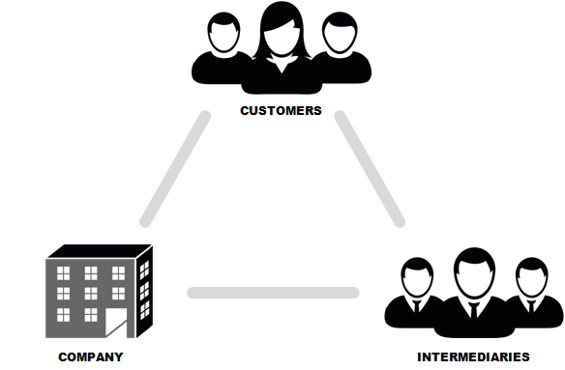

Roles
Source of supply
PATIENTS
Brewers
Wholesaling
“Beer In Grocer” Program
PHARMA NEWCO
Independent
Pharmacists
Grocers
Wholesale operations
Business customers

Slide 18
Joint activities
PRODUCT LISTING
PATIENTS
MARKET OPPORTUNITY
Brewers
Wholesaling
“Beer In Grocer” Program
PHARMA NEWCO
Independent
Pharmacists
Grocers
PRODUCT ORDERING & FULFILLMENT

Slide 19
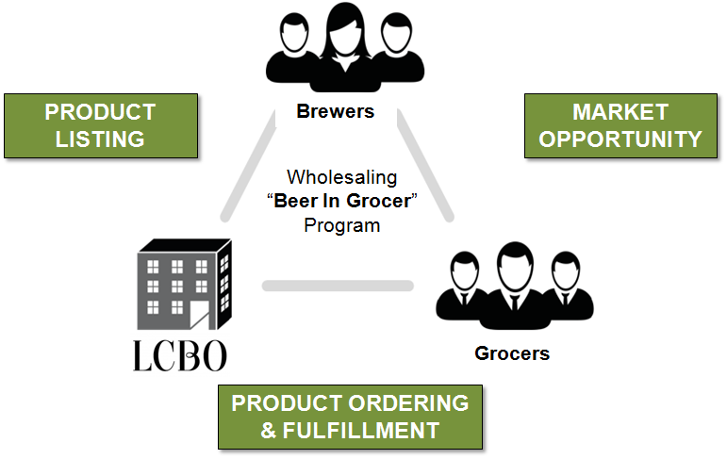
LCBO responsibility
Responsible for awarding wholesale supply agreements for beer to each participating grocer and provide listing services and systems to brewers to access the grocer market.

Slide 20
Brewer responsibility
Responsible for manufacturing and making products available for wholesale through the LCBO, and pursuing product sales and marketing opportunities with grocers.

Slide 21
Grocer responsibility
Responsible for all purchasing decisions on brand and quantity of Beer Products ordered for final retail sale by grocer.

Slide 22
Visibility for products through listing in product registry
Access to grocers
Convenience of 1-stop-shop
Direct wholesaler contact points
Upholding payment terms, on time
Orders processed on time and accurately
Detailed activity
Brand and marketing relationships
Customer insights and segment targeting
Product assortment
Increased distribution & delivery
Fulfillment processing (for all orders, even if not delivered by the LCBO)
Positive experience
Great service provider
Pay on time
Receive and process orders; make it easy to buy

Slide 23


3 - Getting products listed

Slide 24
The beer listing & ordering process provides the ability for:
Manufacturers to post products available for sale to grocers.
Grocers to view available products and place their orders.
LCBO Wholesale Group to process orders and transactions.
All products will be presented fairly and identically across all grocers, according to the standardized product details provided by manufacturers.

Slide 25
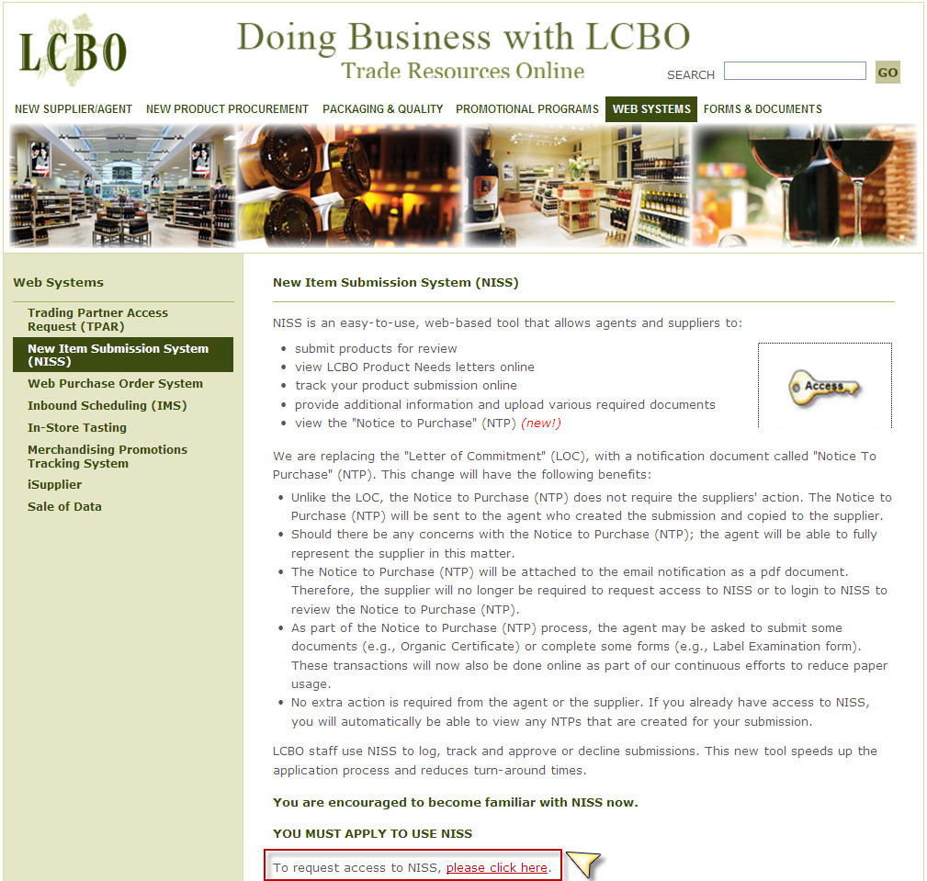



Beer Listing & Ordering System
BREWERS
LCBO
GROCERS
NISS
INTERNAL SYSTEMS
BEER CATALOGUE
New product call in NISS that beer manufacturers use to enter and manage the products that you would like to make available for sale to grocers.
Enterprise-wide platform used by the LCBO and its partners to manage aspects of product listings, inventory, ordering, fulfillment, and transactions.
New online catalogue which provides grocers with the ability to view all beer available for sale and to place their orders.

Slide 26
For existing products:
Existing manufacturers may have products already in LCBO database.
The LCBO will provide a list of products for you to confirm (if any) which existing products you make available to grocers.
You may not elect to have all product varieties offered for sale at the grocer retail level.
  Example: if a manufacturer offers 10 kinds of beer, they may only want a certain 5 to be available for sale through grocers and retain others for other sales channels.

Slide 27
For discontinued products:
The LCBO will provide a list of products for you to confirm which products (if any) you make available to grocers.
    The same LCBO sku# can be reactivated provided there is no change to the product.
If last lab analysis is >365 days, a final lab review is required.
A new quote and retail price must be submitted.

Slide 28
New Item Submission System (NISS)
For new products:
Used to enter and submit a new product.
This will in turn allow for tagging of products intended for grocer retailing.
Tagged products will be reflected in an ordering catalogue for grocers to use.
Submit using:
  Product Need ID # 126 Beer – Grocery Channel 2015/16
  Product Need Item # 2045 Ontario Beer – Grocery Channel

Slide 29
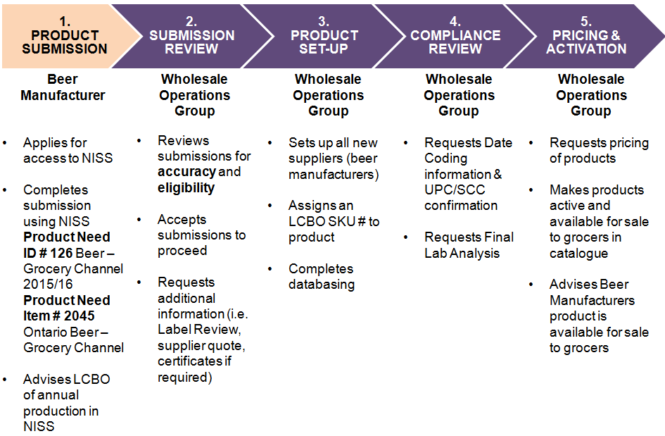
Beer in Grocer Listing Process
29

Slide 30
Beer in Grocer Listing Timeline
Product submissions related to Product Need ID # 126 Beer – Grocery Channel 2015/16 and Product Need Item # 2045 Ontario Beer - Grocery Channel are to be completed between October 8th-30th and the Product Catalogue is to be available to grocers in December.
Timing of stages | Oct 4 | Oct 11 | Oct 18 | Oct 25 | Nov 1 | Nov 8 | Nov 15 | Nov 22 | Nov 29
1. PRODUCT SUBMISSION
2. SUBMISSION REVIEW
3. PRODUCT SET-UP
4. COMPLIANCE REVIEW
5. PRICING & ACTIVATION

Slide 31
Beer Listing Process Additional Information
Open Grocery Call: Following the October call, an ongoing open call will be established.
Streamlined Process: Review of label and final lab only.
Data Integrity: Critical to your success at grocery.

Slide 32
Beer Listing Process Additional Information
LCBO Warehouse: Available to distribute to grocery for products also available through LCBO channel.
LCBO & Grocery Products: New products you wish to make available to both LCBO and Grocery channels are submitted to LCBO product calls – you do not need to submit to both.
Discontinued Grocery Products: Beer manufactures to advise when products are no longer available to grocery.

Slide 33
IT Processes
At the start of the Program, some processes will be manual in nature.
Fully automating our processes will occur on a rolling basis.
The LCBO is working towards electronic transfer and documentation being used for ordering.
The enterprise’s overall direction is to move towards implementation of electronic business practices and solutions.

Slide 34
Continuous improvement
We will maintain ongoing dialogue and feedback with you to ensure all participants in this process quickly get up to speed.
We are committed to making continuous improvements as to how we service and facilitate wholesale transactions between source-of-supply manufacturers and grocer retailers.

Slide 35
Next steps
We will be providing you with:
Detailed process steps to further help guide you.
IT systems and Financial transaction guidelines to follow.
Wholesale Operations Group full contact list.
Follow-up sessions get early feedback and answer questions.

Slide 36
☺ Thank you
Q&A period

Slide 37
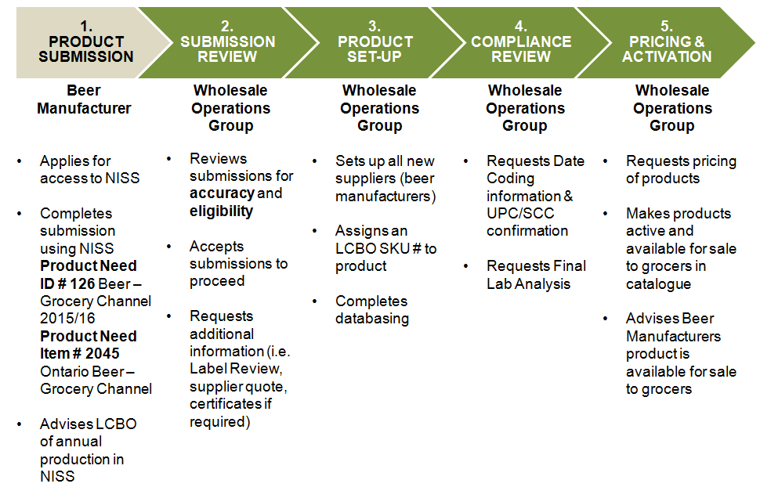
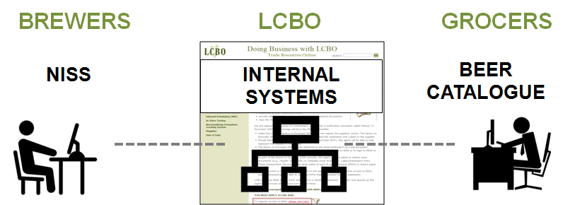
Wholesaling “Beer in Grocer” Program Reference sheet
How it Works
Beer in Grocer Listing Process
Beer Eligibility Requirements
750 millilitres or less.
Total alcohol content cannot exceed 7.1 % ABV.
Only packages with 6 containers or less.
No malt-based coolers.
Grocers cannot have financial interest in a brand or trademark of beer offered.
All products must be made available to all grocers; no exclusive products nor private label brands.
No retail-level discounts or rebates for multiple package buying.
20% of beer on display to consumers must be produced by small brewers (<400,000 hectolitres/yr).
Shelf price = uniform price
https://www.ontario.ca/laws/regulation/150290
Wholesale Operations Group Contacts
Chris Dini
chris.dini@lcbo.com T: (416) 365-5714
Operations: Leanne Rhee
leanne.rhee@lcbo.com T: (416) 365-5889
Invoicing & Payments: Jamie Fazekas
jamie.fazekas@lcbo.com T: (416) 365-5912
Administration: Holly Garner
holly.garner@lcbo.com T: (416) 365-5941 x4059

